Slide 1
2 Reasons Moore’s Law is Ending

Slide 2
Outline
Introduction
Theoretical Limits on Semiconductor Technology
Physical Limits on The Frequency
Conclusion

Slide 3
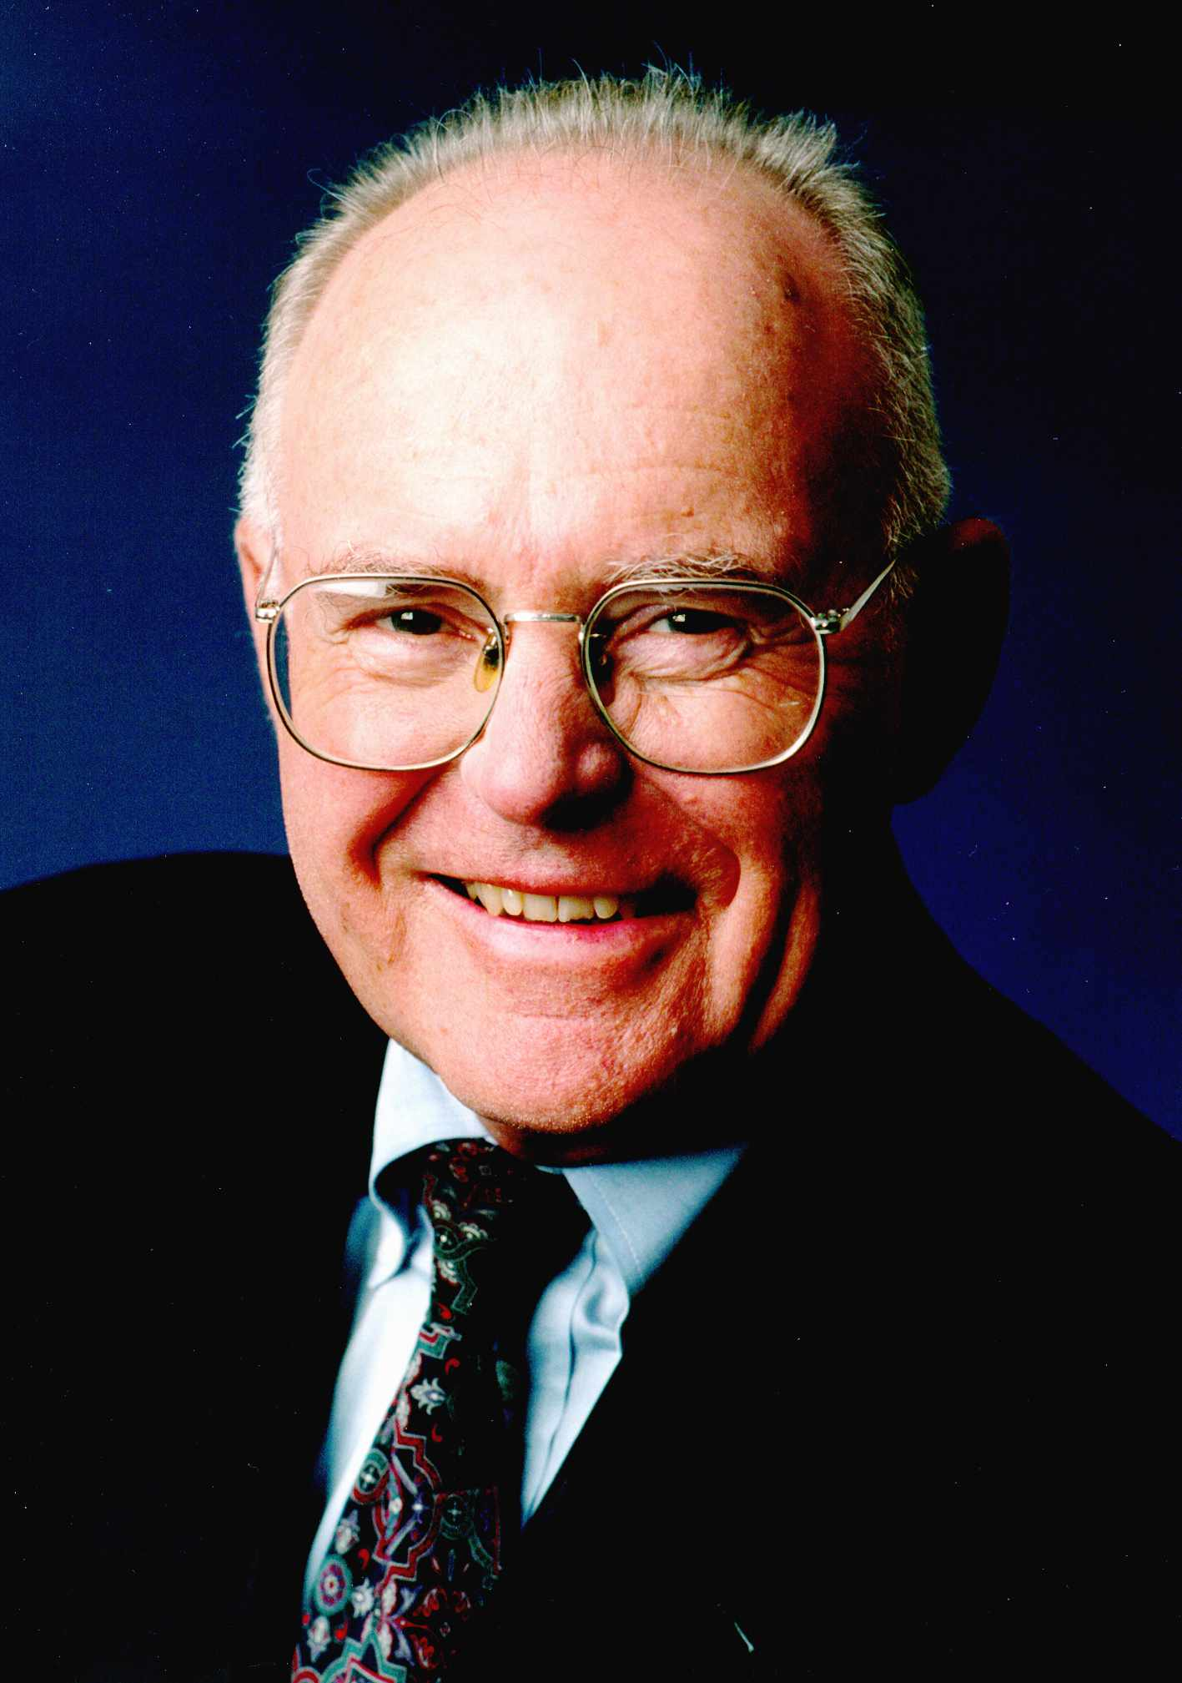
Moore’s Law
Introduced by Gordon Moore on April 19, 1965; on Electronics Magazine.
Observation that the number of transistors doubles about every two years.
Gordon Moore

Slide 4
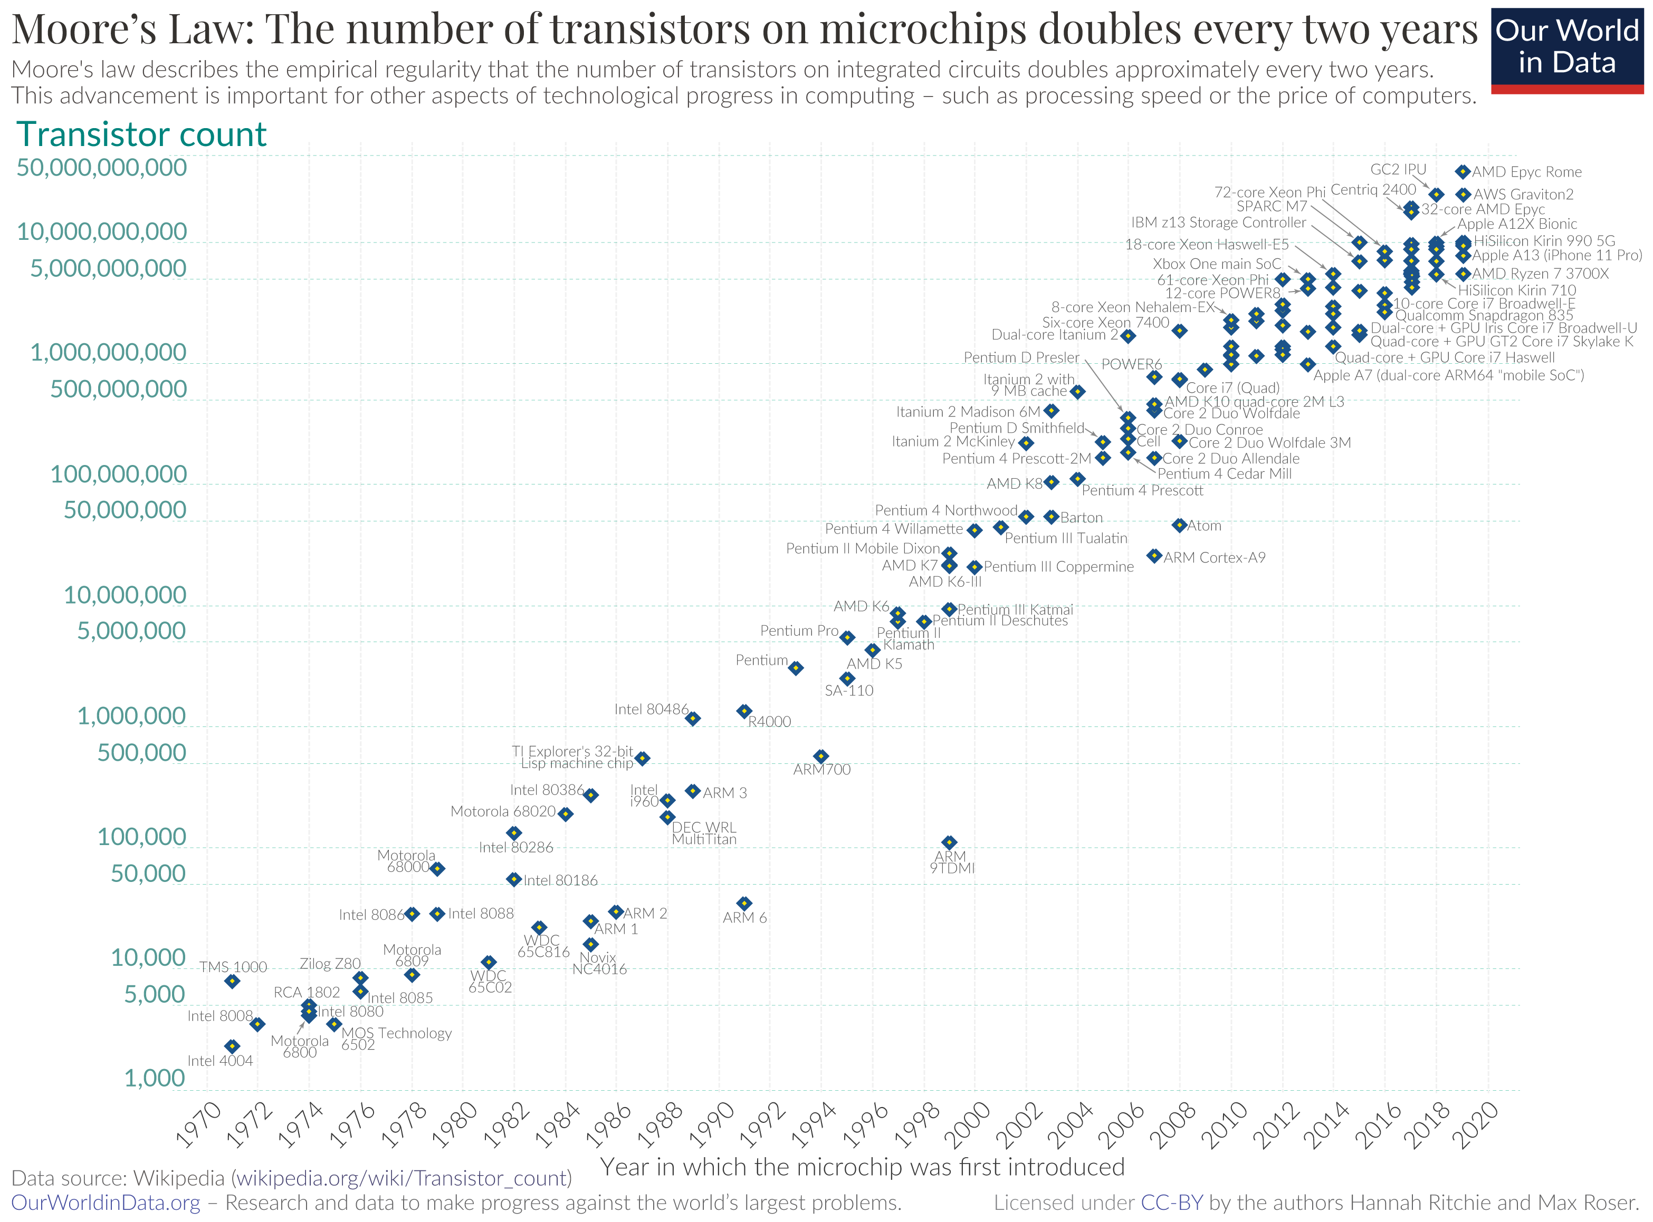

Slide 5
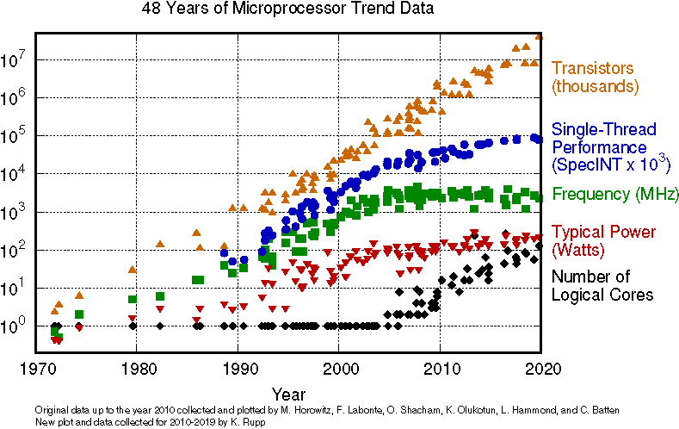

Slide 6
Theoretical Limits on Semiconductor Technology
We cannot manufacture smaller transistors due to technological and
theoretical limits.
Smallest transistor manufactured by IBM is 2nm. (Not used in the industry)

Slide 7
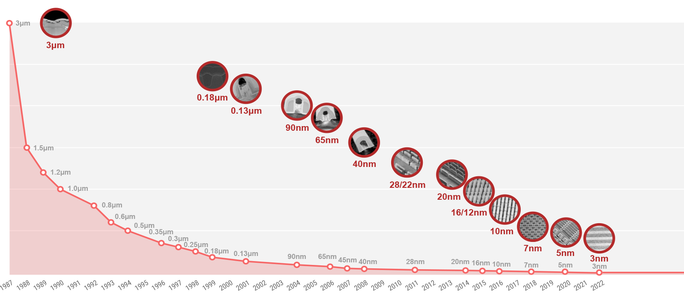
TSMC - 2023

Slide 8
Speed of Electricity
Speed of the processor is limited by the physical world.
Frequency of the processor cannot be increased with current technology.
We have reached the limits of processing based on electricity.

Slide 9
References
Fulton, S. (2020, December 21). Post-Moore’s Law: How Will We Know How Much Faster Computers Can Go? | Data Center Knowledge | News and analysis for the data center industry. Datacenterknowledge. https://www.datacenterknowledge.com/supercomputers/after-moore-s-law-how-will-we-know-how-much-faster-computers-can-go
Herz, D. (2023, February 5). A Century of Moore’s Law - by Douglas Herz - SemiAnalysis. Semianalysis. https://www.semianalysis.com/p/a-century-of-moores-law
Ritchie, H. & Roser, M. (2020, November 1). Moore's Law. Ourworldindata. https://ourworldindata.org/uploads/2020/11/Transistor-Count-over-time.png
(2023, February 20). Process-Technology-Nodes. Tsmc. https://www.tsmc.com/sites/dcom/2023-03/Process-Technology-Nodes_20230220.png

